Slide 1

Numpy, Pandas, Visualization - Part 7
Pandas DataFrame Operations

Slide 2
DataFrame Operations

Slide 3
Checking Duplicates

Slide 4
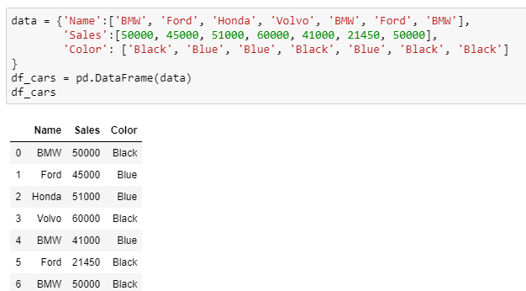
Checking Duplicates
Use the below DataFrame for further manipulations:

Slide 5
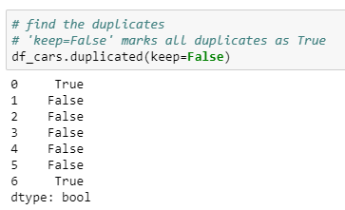
Checking Duplicates
Check the duplicate observations using the duplicated() method
The first and last observation in the dataset is same

Slide 6
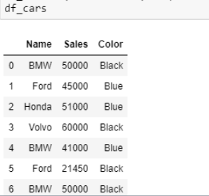
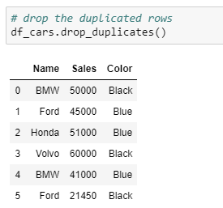
Drop duplicates
Use the drop_duplicates() method to drop the duplicated rows
Before
After

Slide 7
Dropping Rows and Columns

Slide 8
Dropping rows and columns from DataFrame
The drop() method is used to drop the rows and columns that are not required for the analysis
There are scenarios where we need to drop certain rows and/or columns which have missing values, or are redundant with respect to our analysis

Slide 9
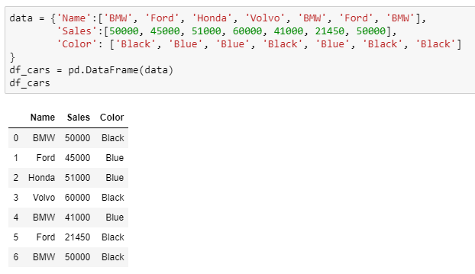
Dropping rows and columns from DataFrame
Use the below DataFrame for the study:

Slide 10
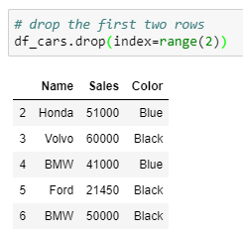
Dropping rows
The drop() method is used to drop the rows with index values
Here ‘range(2)’ is used to drop the first six rows
Pass the row indices to ‘index’

Slide 11
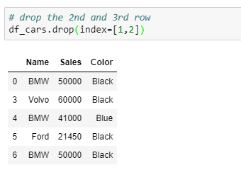
Dropping rows
Pass the list of row indices to drop the rows

Slide 12
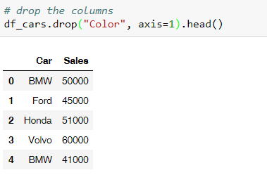
Dropping columns
Pass the column name while setting axis = 1 to drop the column by name

Slide 13
Understanding the ‘inplace’ parameter
We saw how to drop the unwanted rows and column using the drop() method
However, doing so does not delete the rows or columns permanently
To remove them permanently from the data, we use the parameter ‘inplace’ and set it to true
By default, the value inplace is set to false

Slide 14
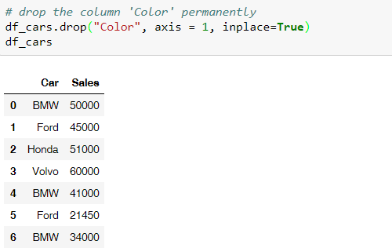
Understanding the ‘inplace’ parameter
Drop the variables ‘Color’ from the dataframe
Removes the columns from the original data

Slide 15
Replacing and Mapping

Slide 16
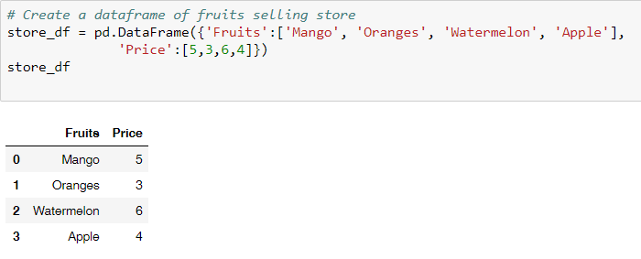
Creating a DataFrame
Use the below DataFrame for the study:

Slide 17
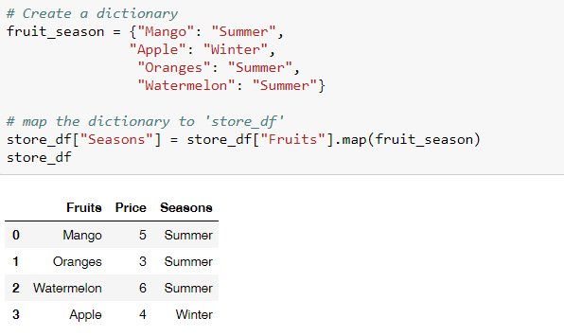
Mapping the dictionary
Use the map() method to create a new column by mapping the DataFrame column values with the dictionary key
Map the dictionary to create a new column

Slide 18
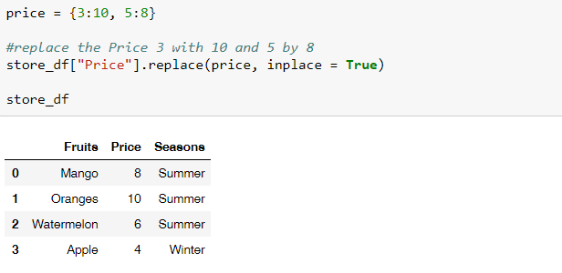
Replace the values
The replace() method is used to replace the values in the DataFrame
Create a dictionary to replace the values

Slide 19
Grouping DataFrame

Slide 20
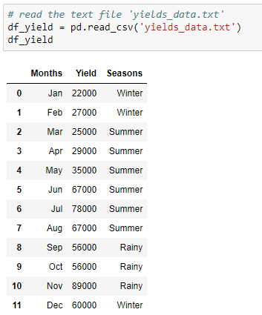
Grouping DataFrame
Use the following DataFrame for the study:

Slide 21
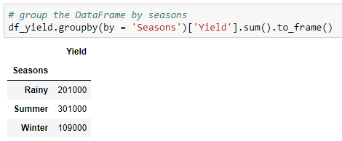
Grouping DataFrame
Use groupby() method to group the dataframe by the specific column(s)
Converts the series to DataFrame
Group the data by ‘Seasons’
Add the values for each season

Slide 22
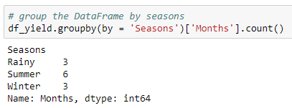
Grouping DataFrame
Get the number of months for each season
Returns the number of months per season
Output as a series

Slide 23
Summary Statistics

Slide 24
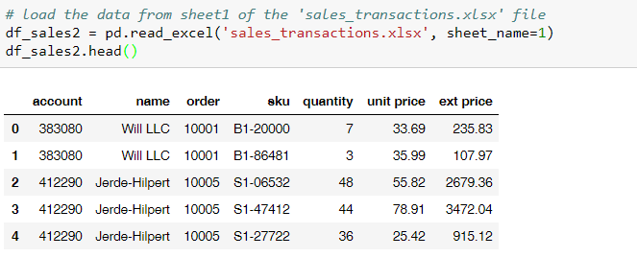
Summary Statistics
Read the excel file “sales_transactions”and print the first five observations

Slide 25
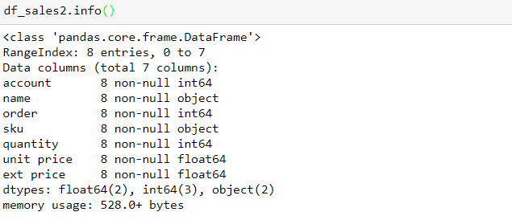
Summary Statistics
The info() returns the information about the type of the object, shape, number of non-null entries in each variable, and the data type
Returns the number of columns for each data type

Slide 26
Summary Statistics
Summary statistics of the DataFrame is obtained using the describe() method
By default, it returns the summary of the numeric variables
Summary statistics of the categorical variables is obtained using the describe(include =['object'])

Slide 27
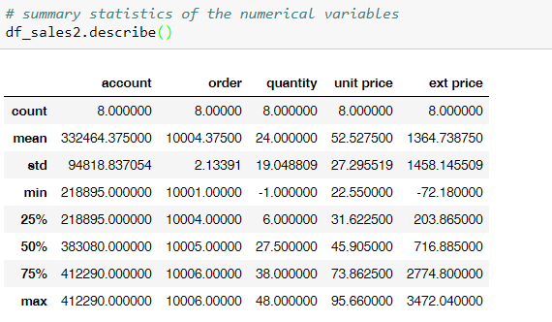
Summary statistics of numerical variables
count | Total number of observations
mean | Average value
std | Standard deviation
min | Minimum value
25% | First quartile
50% | Second quartile (median)
75% | Third quartile
max | Maximum value

Slide 28
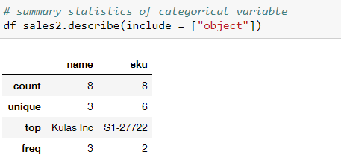
Summary statistics of categorical variables
count | Total number of observations
unique | Number of unique categories
top | Category with highest frequency
freq | Frequency of the ‘top’ value

Slide 29
Skewness and Kurtosis

Slide 30
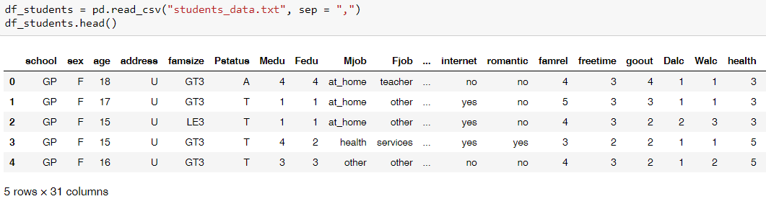
Skewness and Kurtosis
Read the csv file “students_data” and print the first five observations

Slide 31
Skewness
Skewness refers to lack of symmetry or distortion in symmetric bell curve
If the distribution of the data is elongated on either sides then the data is said to be skewed
If the distribution of the data is elongated on the left side then the data is said to be left skewed
If the distribution of the data is elongated on the right side then the data is said to be right skewed

Slide 32
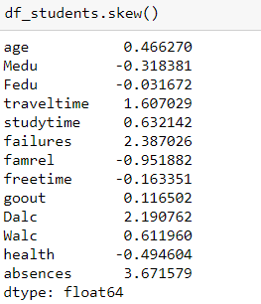
Skewness
Returns the skewness of numeric variables
Skewness | Interpretation
= 0 | No skewness
> 0 | Right Skewed Distribution
< 0 | Left Skewed Distribution
Skewness of the numeric variables

Slide 33
Kurtosis
It is a statistical measure that defines how heavily the tails of the distribution differ from the normal distribution
It identifies whether the tails of a given distribution contain extreme values
Thicker the tails are more the extreme values in the data

Slide 34
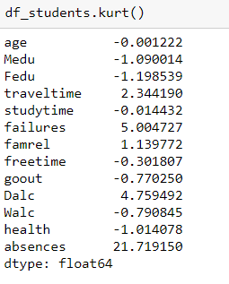
Kurtosis
Returns the kurtosis of numeric variable
Kurtosis value | Interpretation
= 0 | Mesokurtic distribution
> 0 | Leptokurtic distribution
< 0 | Platykurtic distribution
Kurtosis of the numeric variables

Slide 35
THANK YOU
Presenter’s Name
Contact Us
support@knowledgehut.com
Presenter’s Designation

